Slide 1

E-Voting DApp
Sahildeep Singh Raina 20158070
Sarvaigari Govardhini 20158094
Ayush Jain 20158014
Gourav Kumar 20158098
Tejaswini Sundar 20158008
Under the guidance of
Dr. Divya Kumar

Slide 2
Task At Hand
Democracy, most stable and favoured form of governance.
Elections play a pivotal role.
Need a way to conduct fair elections.

Slide 3
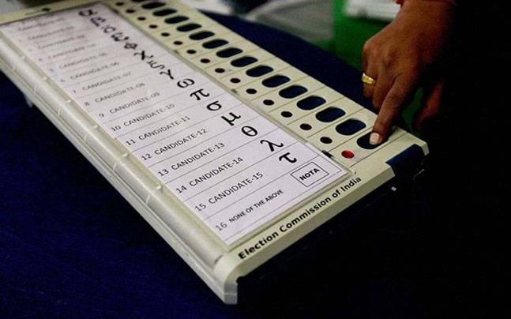
Current System
Currently, elections are conducted using the following methods predominantly:
Paper Ballot System
Electronic Voting
Machines

Slide 4
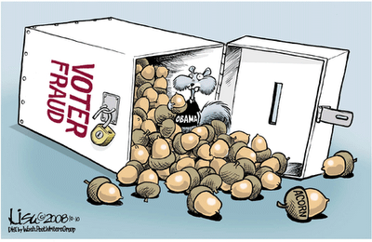
Current System - Drawbacks
There are many problems associated with current methods employed to conduct elections. Some of them are:
Privacy Of Voter
Malpractices
Need for trust in third parties
Inconvenience

Slide 5
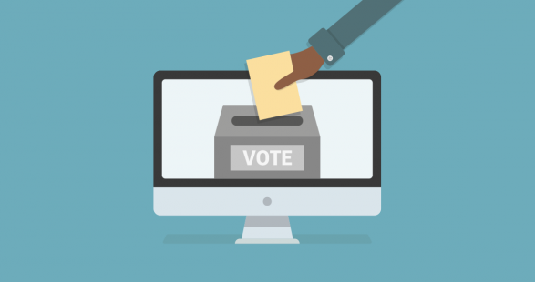
Our Proposal
We propose to overcome the drawbacks of existing voting systems using a blockchain backed web based application.

Slide 6
Theory
The proposed system uses the following concepts and technologies for ensuring that fair elections are conducted:
Blockchain
Smart Contracts (Solidity)
Front End (HTML, CSS, JS)
Web 3.0
All of these concepts and technologies are explained briefly.

Slide 7
Blockchain
A blockchain is a growing list of records, called blocks, which are linked using cryptography.
Each block contains the following:
A cryptographic hash of the previous block
A timestamp
Transaction data

Slide 8
Blockchain
Blockchains are of three types:
Public
Private
Consortium
Different types of blockchains can be used according to individual requirements.

Slide 9

Smart Contracts
A smart contract is a computer protocol intended to digitally facilitate, verify, or enforce the negotiation or performance of a contract.
Smart contracts allow the performance of credible transactions without third parties.
These transactions are trackable and irreversible.
Smart Contracts are written in Solidity.

Slide 10
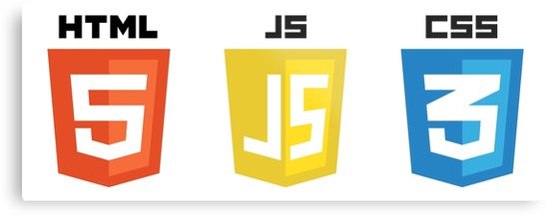
Front End
A simple and easy-to-use front end is developed using HTML, CSS and JavaScript.
The front end interacts with end users ( candidates and voters).
It is used to interact with the smart contracts easily.

Slide 11
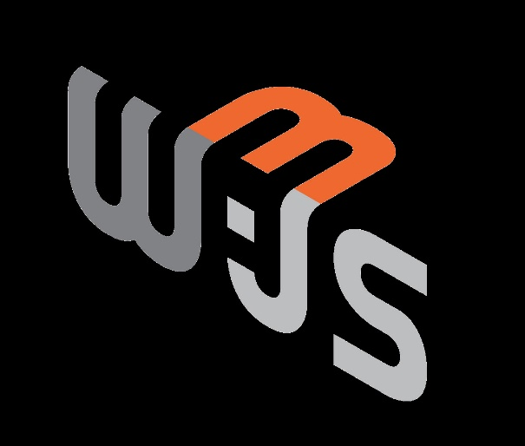
Web 3.0
There is no concrete definition for Web 3.0 yet and the technology that will bring us there has not even matured yet.
Web3 is based on context based browsing.
The web3.js library is a collection of modules which contain specific functionality for the ethereum ecosystem.
The web3-eth is for the ethereum blockchain and smart contracts.

Slide 12
Working
CANDIDATES
SMART CONTRACT
( BACK END )
FRONT END
( HTML/CSS/JS )
WEB3.js
VOTERS

Slide 13
Working
Users press buttons in front end
CANDIDATES
SMART CONTRACT
( BACK END )
FRONT END
( HTML/CSS/JS )
WEB3.js
VOTERS

Slide 14
Working
Front end calls functions of JavaScript
CANDIDATES
SMART CONTRACT
( BACK END )
FRONT END
( HTML/CSS/JS )
WEB3.js
VOTERS

Slide 15
Working
JavaScript calls functions provided by the smart contract
CANDIDATES
SMART CONTRACT
( BACK END )
FRONT END
( HTML/CSS/JS )
WEB3.js
VOTERS

Slide 16
Working
Smart contract executes the functions and records transactions
CANDIDATES
SMART CONTRACT
( BACK END )
FRONT END
( HTML/CSS/JS )
WEB3.js
VOTERS

Slide 17
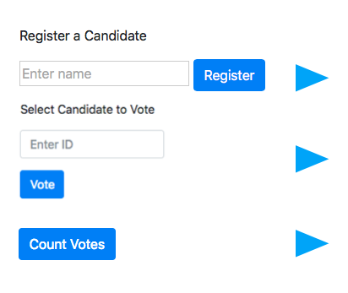
Insight
Registers the candidate with the given name.
Allows the user to vote for a candidate with the given ID.
Allows anybody to tally the number of votes.

Slide 18
Advantages
Trustworthy system
Transparency
Faster transactions
Reduced transaction costs
Ease of usage

Slide 19
Features Not Included
Voter registration and verification is not yet included in this system.
Also, the system runs on private blockchain. So, full potential of blockchain is not harnessed.

Slide 20
Future Work
Switch to public or consortium blockchain
Include voter registration, verification and other features
Cryptographic security can be increased

Slide 21

Demo

Slide 22
Citation
Image source:
https://www.indiatoday.in
http://joshuapundit.blogspot.com
https://atelier.bnpparibas
https://en.wikipedia.org/wiki/Solidity

Slide 23
Conclusion
Thank you for your patience.
We will be happy to answer any questions or doubts.

